Slide 1

Computer Vision-based Object Recognition Name: Sahil Singh Rana Course: B.Tech Computer Engg. (AI &DL) University roll no. : 2019582 Roll no: 19 Section: CE SPL

Slide 2

Introduction
Object detection, a fundamental task in computer vision, plays a crucial role in numerous real-world applications such as surveillance, autonomous vehicles, medical imaging, and retail analytics. It involves identifying and locating objects of interest within images or video streams, enabling machines to interpret visual data and make informed decisions.
The primary objectives of this project are to develop an object detection system using the YOLOv8 model, implement a user-friendly graphical user interface (GUI) for image and live camera detection, and evaluate the performance of the system on various inputs.

Slide 3

AIM -
To develop a robust computer vision-based object recognition system using the YOLOv8 model for real-time detection and classification of objects in images and live video feeds.
To develop an object detection system using the YOLOv8 model.
To implement a user-friendly graphical user interface (GUI) for image and live camera detection.
To evaluate the performance of the system on various images and live feeds.
OBJECTIVE -

Slide 4

Methodology
Input:
Accepts images from file uploads or live camera feeds.
Preprocessing:
Resizes and normalizes input images for consistent model performance.
Detection:
Uses YOLOv8 to detect objects, returning class labels, bounding box coordinates, and confidence scores.
Post-processing:
Draws bounding boxes and labels on detected objects for visual output.
Data Pipeline Diagram
Flowchart:
Image Input → Preprocessing → Detection → Post-processing → Output Display

Slide 5
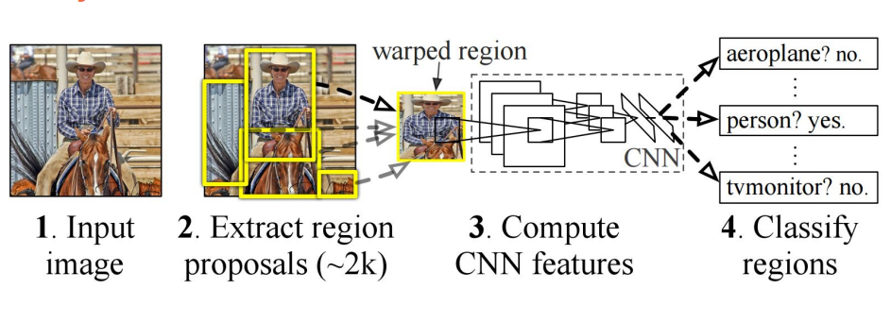
Implementation Details
Software and Libraries
Programming Language:
Python for implementation.
Libraries:
OpenCV: For image processing and capturing camera feed.
Tkinter: For creating the graphical user interface.
Ultralytics YOLO: For YOLOv8 model integration.
User Interface and Image Input
Design of User Interface:
Developed using Tkinter for user-friendly interaction.
Image Input Options:
Functionality for image input via file browsing or live webcam capture.

Slide 6
Image Processing with OpenCV
Image Capture:
Function: capture_image_from_cam_into_temp()
Captures images from the webcam and saves them to a temporary directory.
Object Detection:
Function: check(window, path1)
Uses YOLOv8 model to detect objects in selected or captured images.
Draws bounding boxes and labels for detected objects.
Image and Video Processing
Live Video Detection
Live Detection:
Function: live_detection()
Captures real-time video from a webcam.
Continuously performs object detection using the YOLOv8 model.
Error Handling
Error Messages:
Informative messages for issues like file not found or no objects detected.
Library: Tkinter's messagebox for user alerts.

Slide 7

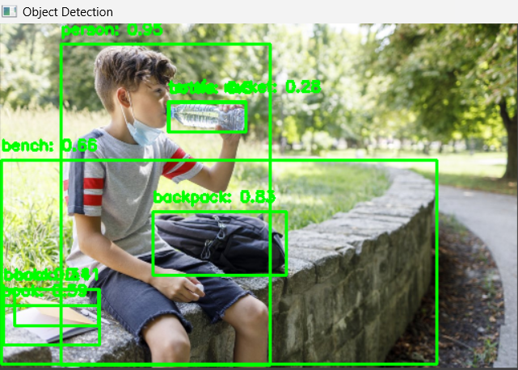
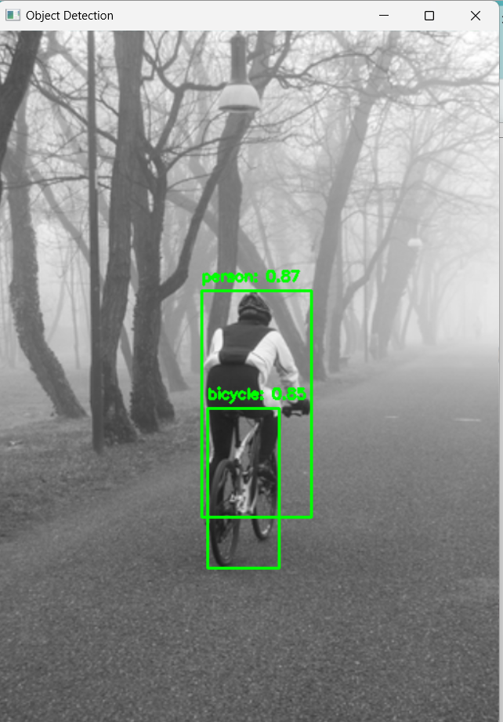
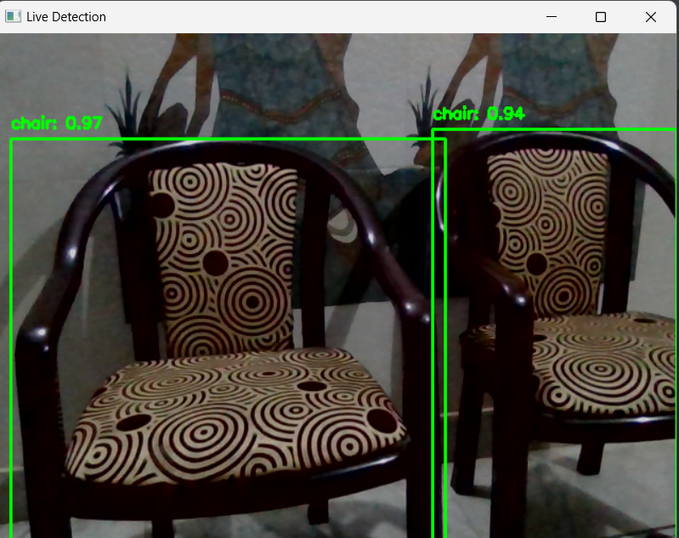
RESULT AND DISCUSSION
Accuracy: The accuracy of the system was found to be 80-90%.
Successful Object Detection
Performance under Different Lighting
Tkinter-based GUI
for live video detection.

Slide 8
Future Improvements
Improving Small Object
Detection
Reducing False Positives
Exploring better post-processing techniques to minimize false positive detections and improve overall reliability.
Enhancing the detection accuracy for small objects to further expand the system's capabilities.
Enhancing the GUI
Mobile Integration
Adding features like object tracking to the graphical user interface for more advanced functionality.
Exploring the integration of the system with mobile devices to enable on-the-go object detection capabilities.

Slide 9
CONCLUSION
High Accuracy
Effective Image and Video Processing
User-Friendly InterfaceReal-Time Detection

Slide 10
thankyou

